Slide 1
Bar-B-Queing Shakespeare
King and Sultan on the Grill
Notes:
Raw meat is not something we eat… unless it’s sushi… fish… and even that is not appealing to everybody. In order to enjoy a good piece of meat we generally cook it… transform it into something tasty, palatable – and everybody loves the taste of BBQ’d meat. Well, Shakespeare and his most tragic play, King Lear, is like raw meat in this context… so the enlightened lecturers decided to let the students BBQ it. The metaphor is not hard to understand. Shakespeare is a brilliant playwright, arguably the best in history. The fact that he wrote his plays some 500 years ago, in what we call old English - a language unto itself – far different than the English we use today – and contain symbols, imagery, and allusions to forgotten or fictitious events that historians and literary critics still struggle to understand, makes it an unwise choice for use in developing the English language abilities of our students. Many of the literary devices he uses are understandable and wonderful examples but most relevant, the themes in his work are universal and have stood the test of time. So tenderising and BBQ’ing the language and other aspects of the play, so they become manageable, productive and useful, tasty if you like, made sense. For the lecturers involved I turned the project into three courses, Pre-production, Rehearsals, and Final rehearsals, Production and Post production suitable for this context and secondary schools who have the opportunity to mount full productions of plays. We will see some aspects of these courses in the following presentation. It wasn’t easy to choose some 30 pictures out of over 350 I have of the process for a 20 slide presentation limited to 20 seconds per slide to describe a few aspects of the process but I know most of you will be able to fill in the gaps from your memories of the time we had to work together on this project. I’d like to thank Izzati and Ck for their support and input during the courses, and most of all thank you, members of the Sem 2 cohort for being so welcoming and receptive to me and my experience with Mistress Theatre I was able to share with you. Now let the show begin.

Slide 2
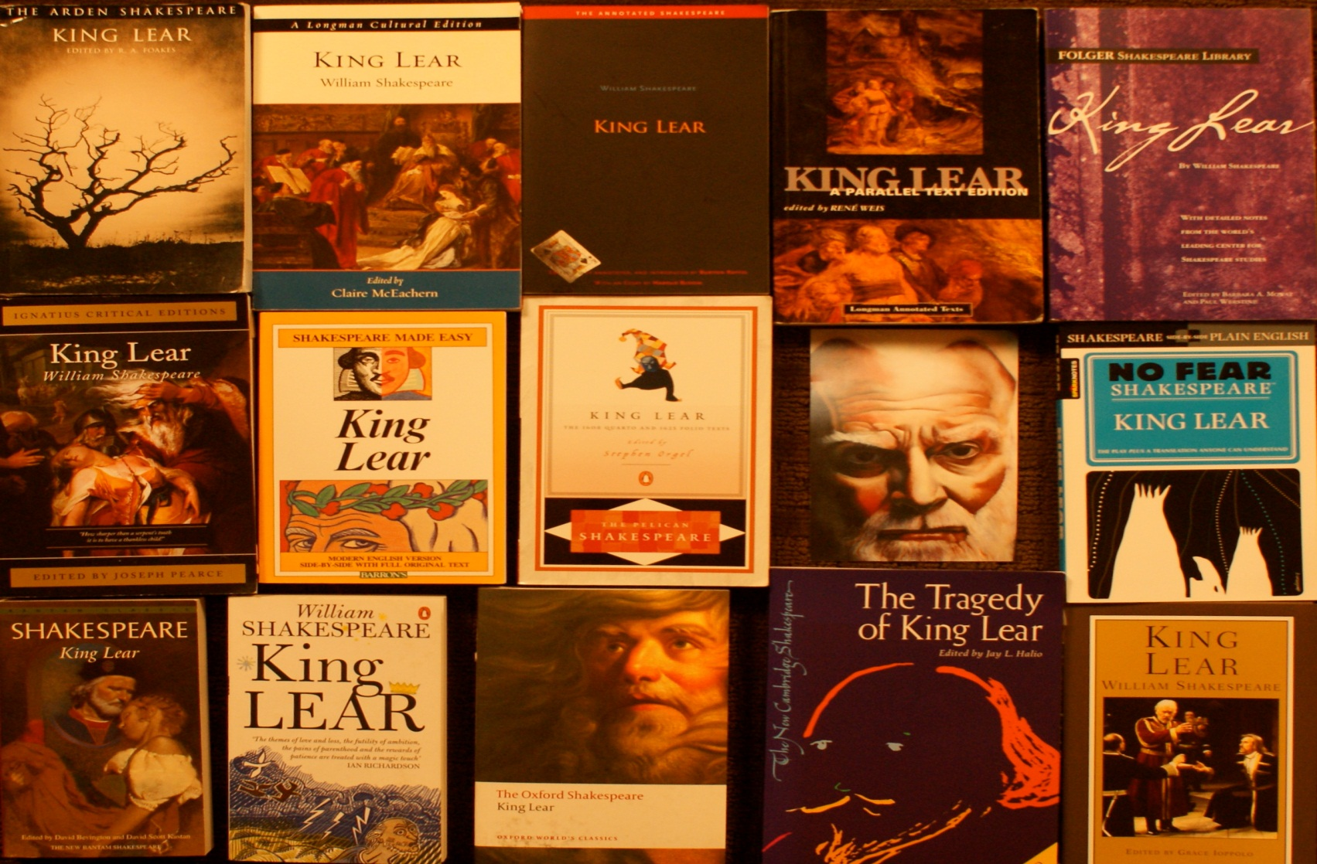
Notes:
Slide 1 - Course 1 – Pre-Production Starts with a play – in this case King Lear was mandated by the curriculum. However, alternatives are a play chosen by the students cooperatively with teachers or one written by the students. In between these options is having the students adapting a play that is beyond their language abilities.

Slide 3
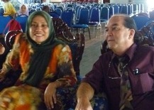
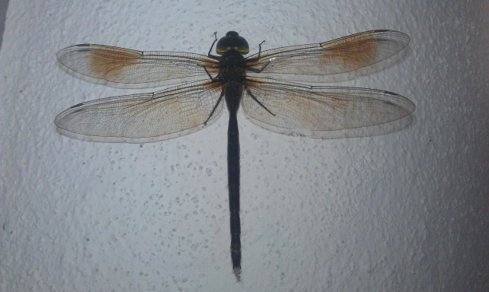
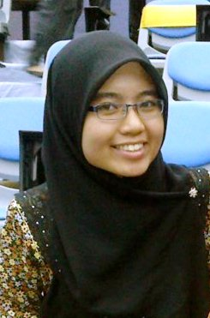
Notes:
Slide 2. Adapted script – King Lear became Sultan Mahmud Leman Shah. I like this option because it presents the students with the opportunity to understand elements of character, meaning of dialogue, themes and other literary devices while keeping the language within the range of their abilities and providing opportunities to reasonably expand their use of English. Script writing was undertaken by the whole cohort. The Dragon Fly appeared outside my office just before final rehearsals – a very good oman.

Slide 4
Notes:
Slide 3. An added advantage is it provides the opportunity to deepen an understanding of other important information; in this case the play was set in a Malaysian historical period (1488 -1528) in Malacca when the true Sultan Shah reigned and the set, actors’ mannerisms, etc. reflected that period. It even included a traditional dance, a mix of Gazal and Zapin, I think.

Slide 5
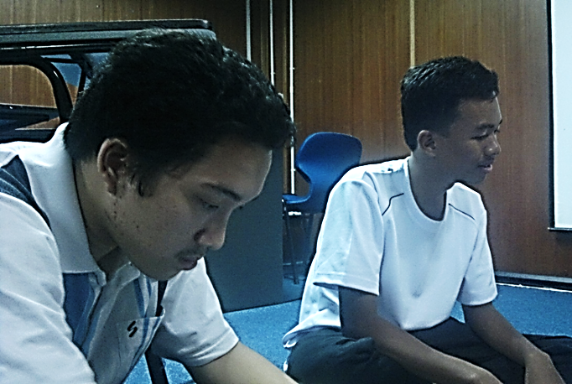
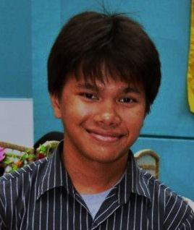
Notes:
Slide 4. Assignment of Roles: Election of Director and Assistant Director, casting, and Committees. The Director, Syam upper Left, and Assistant Director, Adam right, were elected by the cohort and other roles were subsequently assigned by the D and AD including the important responsibility of Stage manager (Nazmi – Lower left) who oversees all other committees for the play: costumes, set, props, lighting, make-up, etc. each of which had a coordinator. Izzati and CK Center, principle students of the courses, oversaw the process.

Slide 6
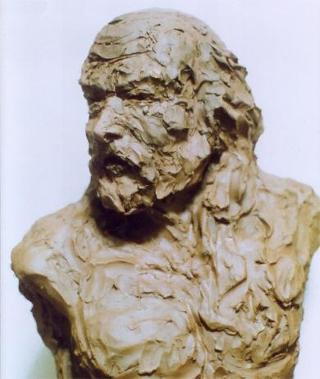
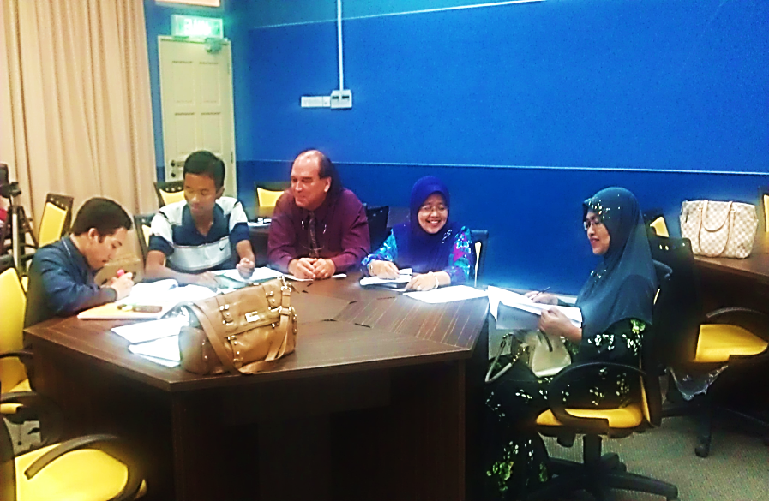
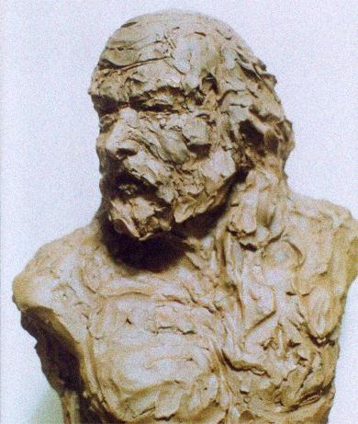
Notes:
Slide 5. Casting: students were free to try-out for any role and the final decision was made by a committee of students and teachers. It is important to do the best to match up students’ physical, vocal and performance characteristics as well as their ability to grow in the language demands of their roles. The choices were not easy as everybody was enthusiastic.

Slide 7
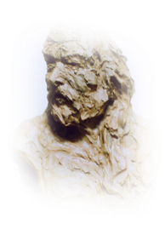
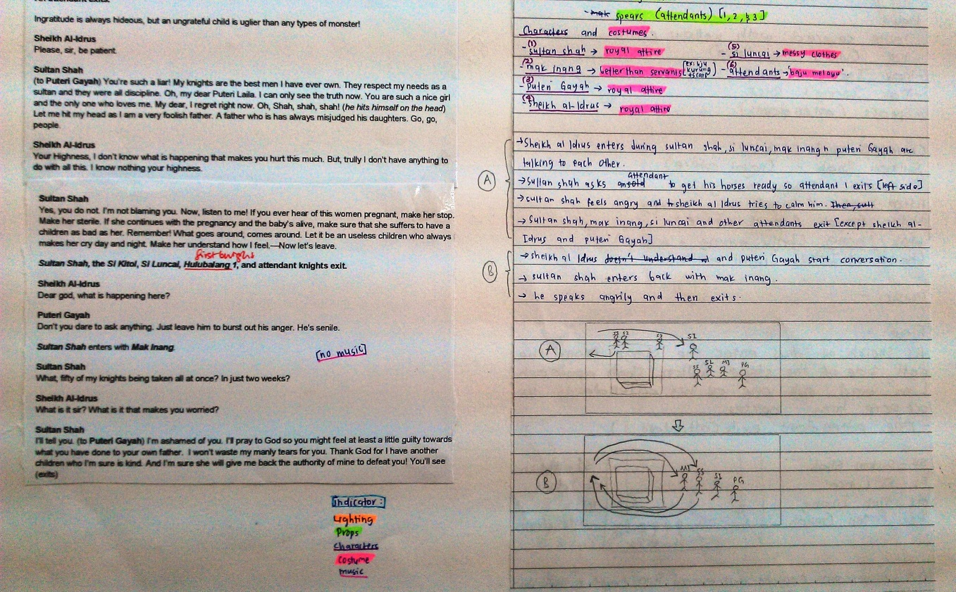
Notes:
Slide 6. Course 2 – Rehearsals –The concepts of Blocking (actors positioning during scenes) and the Stage Manager’s need for a Playbook to keep track of all aspects of the staging, blocking, set changes, costume changes, lighting changes were explained and the necessary materials obtained. Stage manager Nazmi, caught on quickly and did an excellent job. The SM did a great job. (show books)

Slide 8
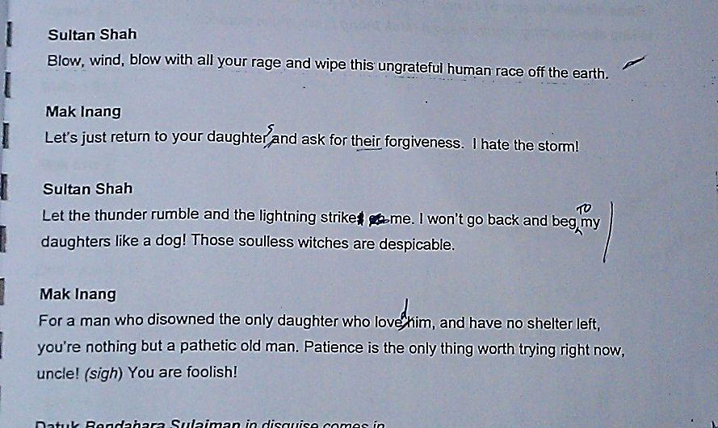
?
Notes:
Slide 7. Actors began memorising their lines (easier for some than others) and script editing began and was ongoing throughout the rehearsals. In terms of language development this aspect was of greatest benefit to the students. Understanding of the themes, symbolism and metaphors in the play were discussed, revealed and deepened.

Slide 9
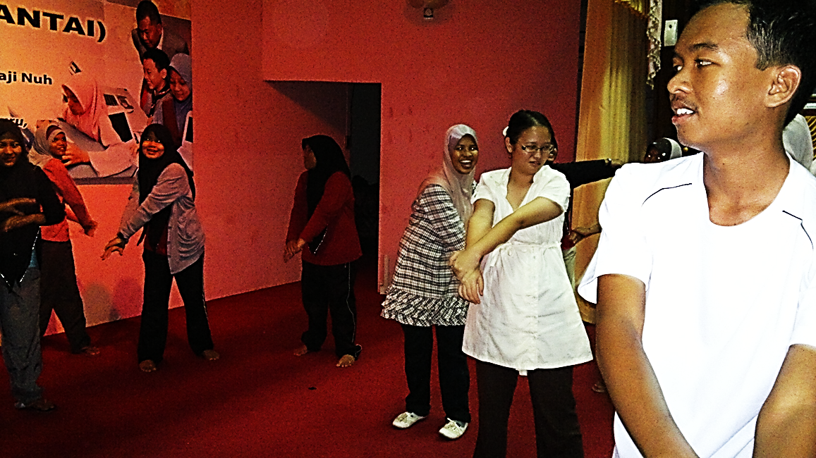
Notes:
Slide 8. Very important aspects of the rehearsal stage, especially for budding teachers, were the warm-up exercises done before each rehearsal began. These are necessary for development of voice control and projection used by professional actors always and handy in a classroom. First step are breathing exercises to feel and expand the muscles that control breathing: rib cage and diaphragm.

Slide 10
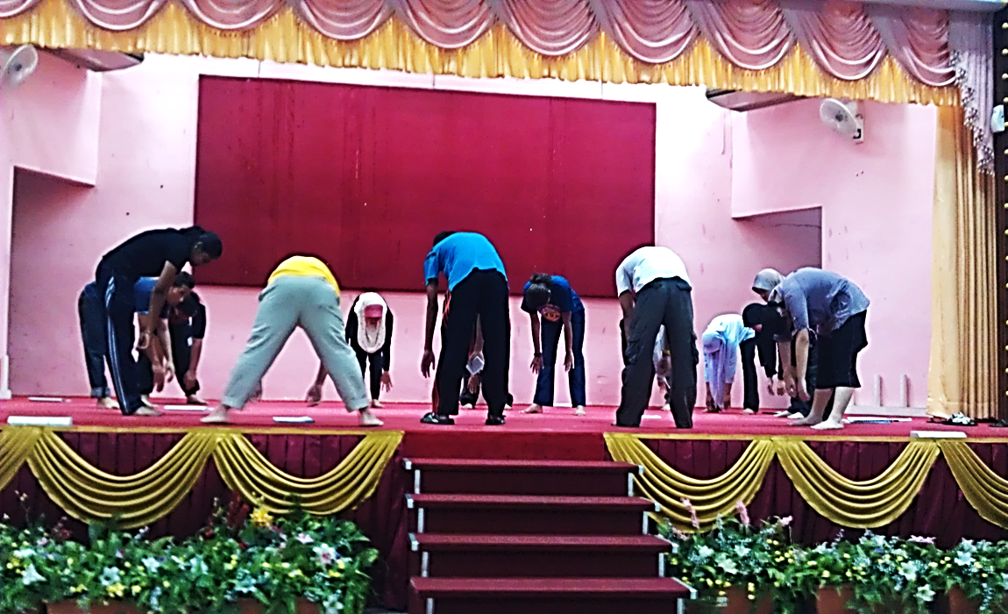
Notes:
Slide 9. Next are resonance exercises. Various means of Humming are the central techniques. Floor, top of head to ceiling, and out to audience. These help relax and loosen the body and help with projection. Pant splitting is a potential hazard. (Demo)

Slide 11
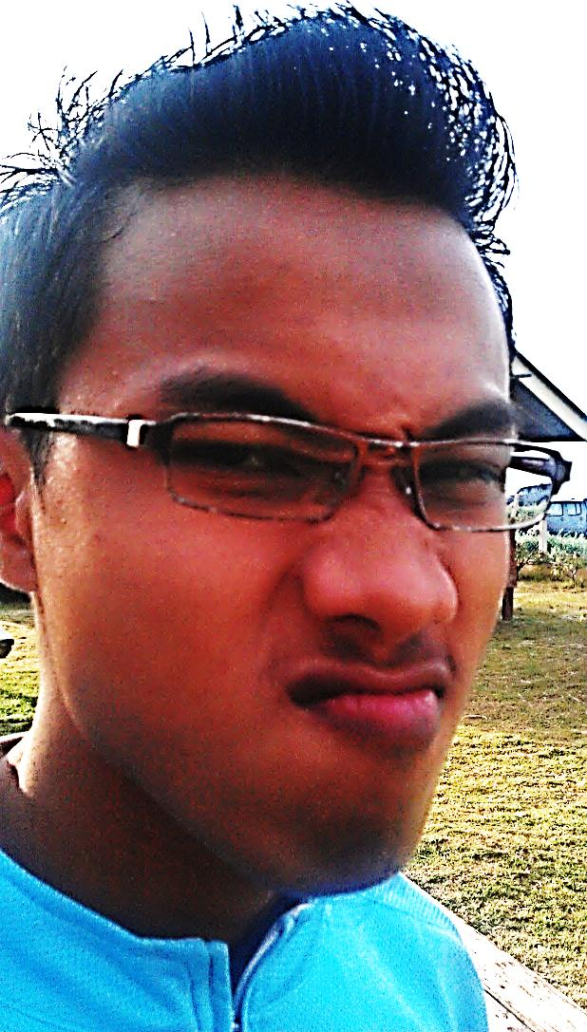
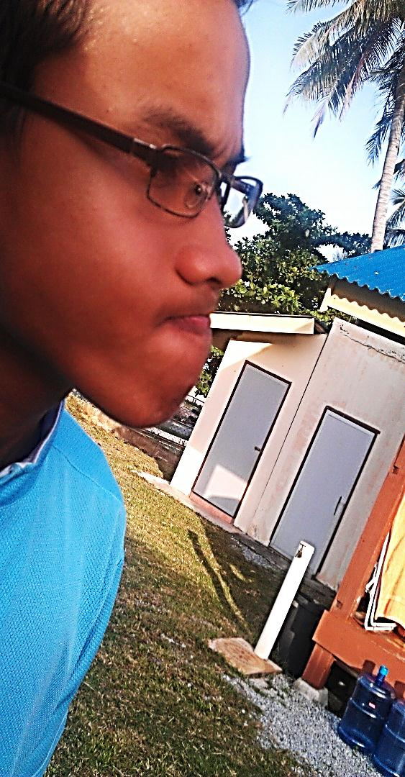
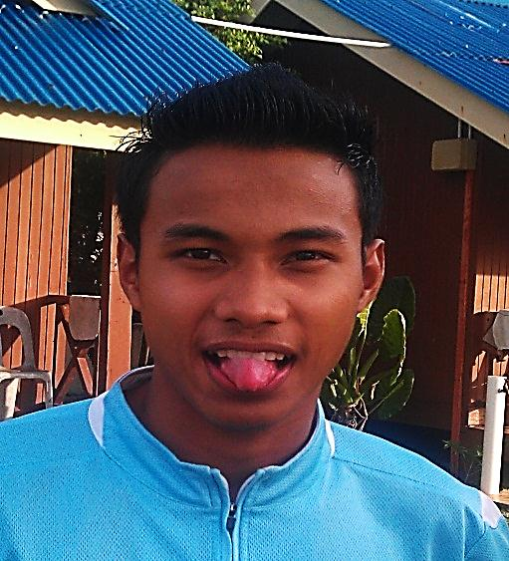
Notes:
Slide 10. The third set of warm-up exercises focus on articulation and involve facial, tongue and head muscle movements. Sticking out and maneuvering the tongue, contorting the facial muscles, then tongue twisters or just practicing sounds that are difficult (Father vs Fodder) are all effective and good fun. (Goose sound)

Slide 12
Notes:
Slide 11. During this period the actors are memorising their lines, Director and his Assistant busy with blocking changes to reinforce themes and symbolism through set and props and characters’ body language, gesture, posture, pacing, and stage action all the while co-ordinating changes recorded by the stage manager. (Bottom left)

Slide 13
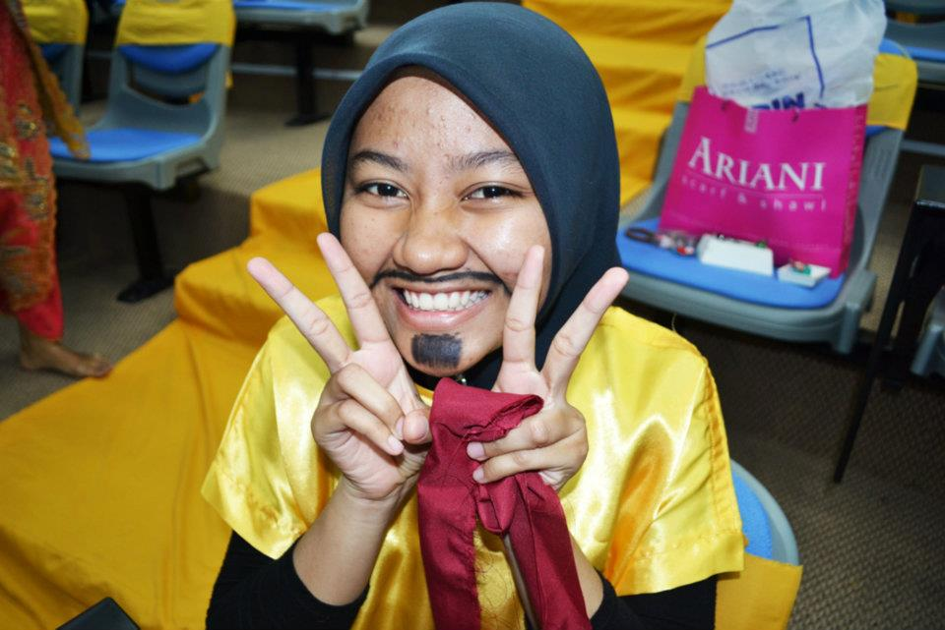
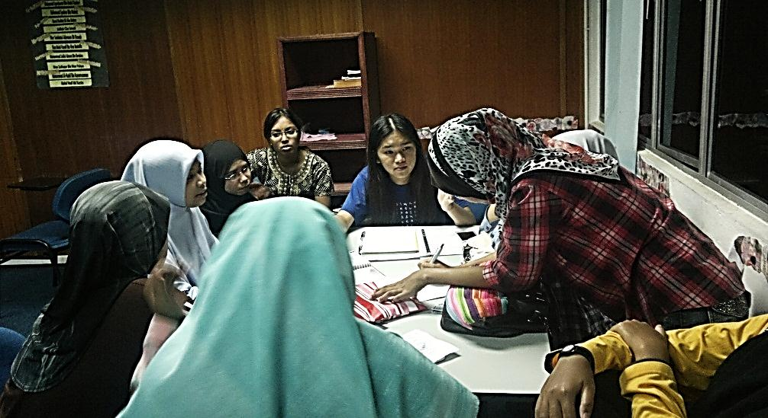
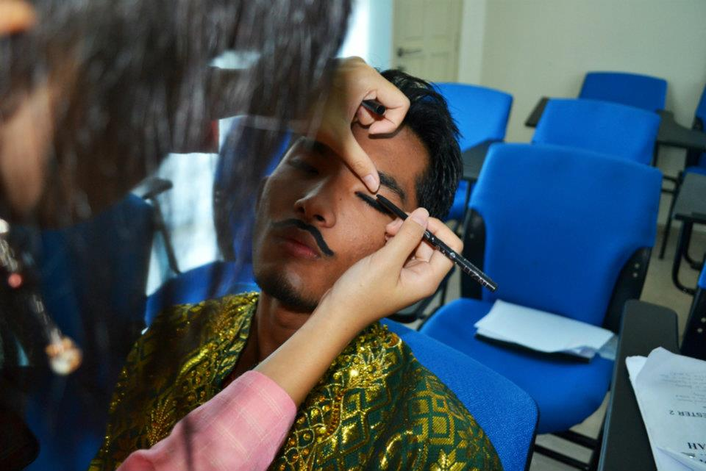
Notes:
Slide 12. All the while the back stage crews are busy planning and building props, finding or making costumes, deciding on make-up and stage dressing… and all on a very limited budget that came mostly out of their own pockets! Under these circumstances they did a terrific job!

Slide 14
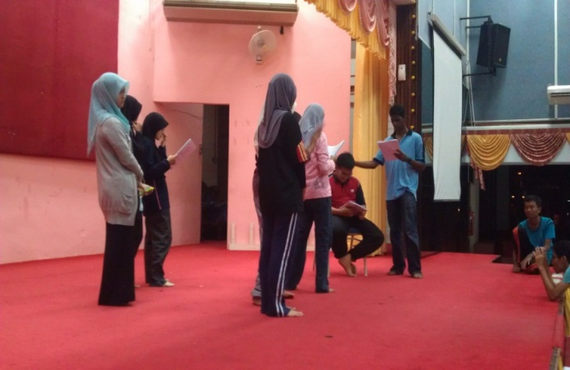
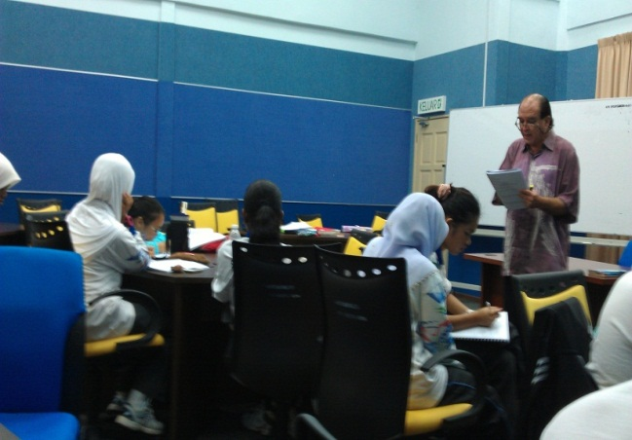
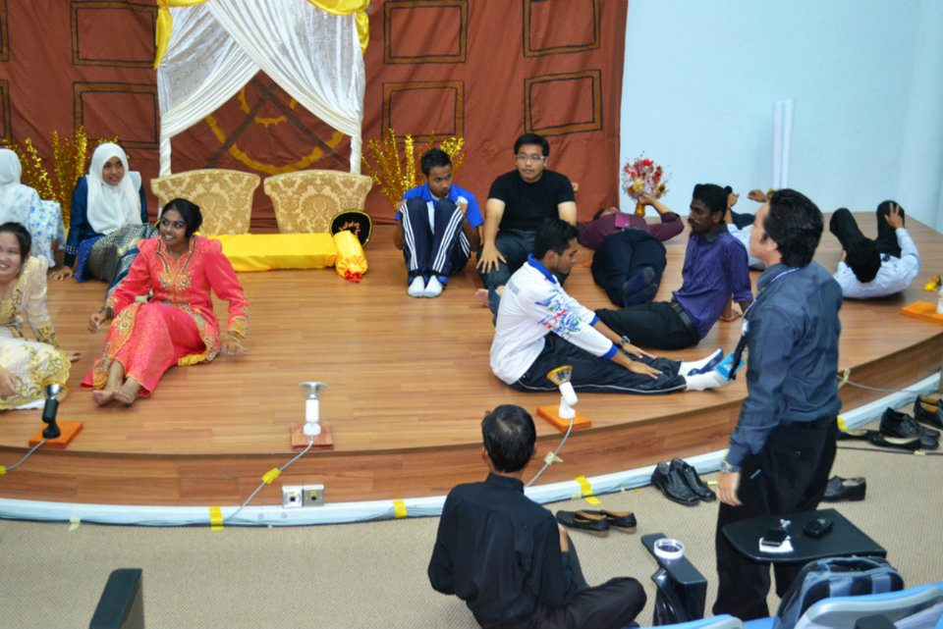
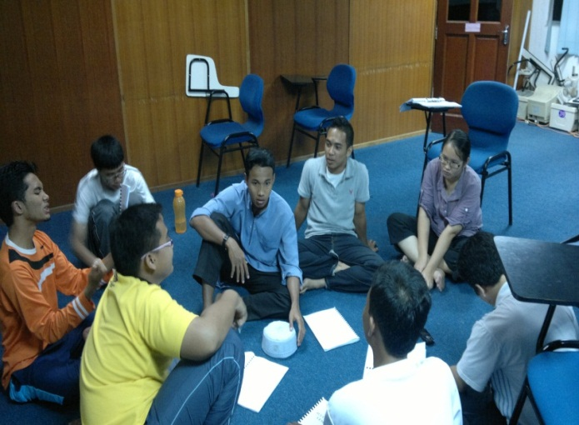
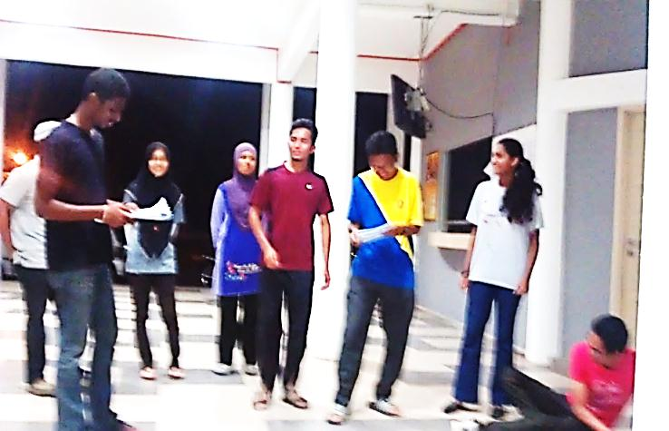
Notes:
Slide 13. Course 3 – Final Rehearsals, Production, Post-Production - Rehearsals were difficult. Originally scheduled for Al Farabi, a power outage on the old campus which affected the student housing as well, forced the Director and cast to find and use alternative spaces. We used a room in BKU when they had temporary generators and the lobby of the TELTtrac campus before finally, at the last minute, we could arrange for use of the TELTtrac hall where the play was booked for performance.

Slide 15
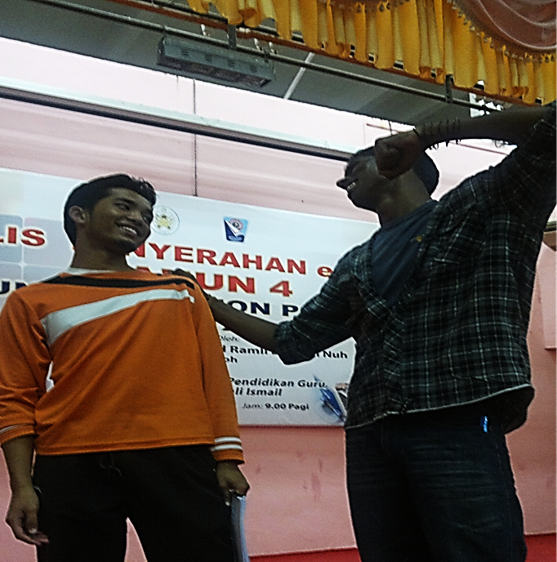
Notes:
Slide 14. The changes and frustration began to take its toll. Here Don thought gardening would be much more fun and productive. Plastic Flowers? (Don seemed to be in his own world many times) but he was quickly reminded to get back into his role by Theebon…. or suffer serious consequences… all in good fun of course.

Slide 16
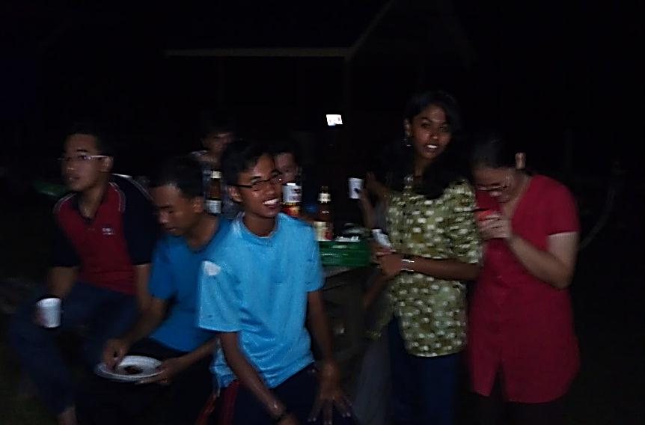
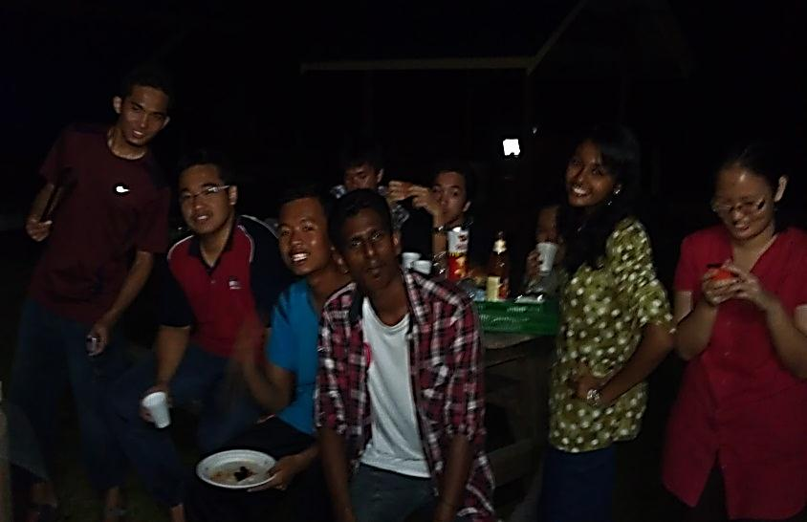
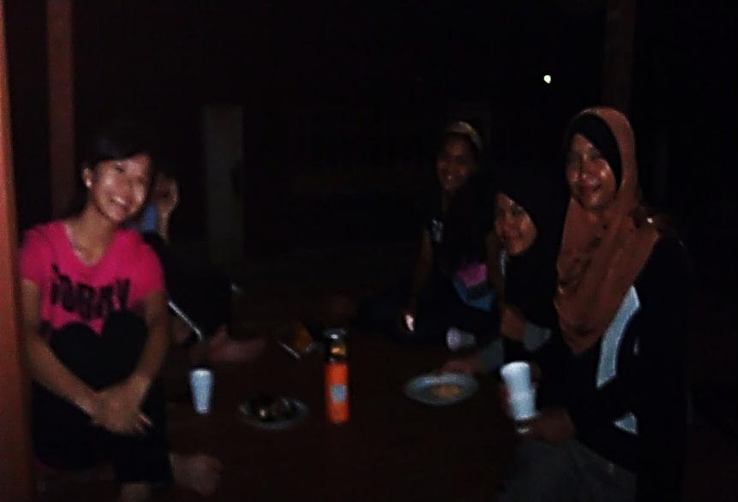
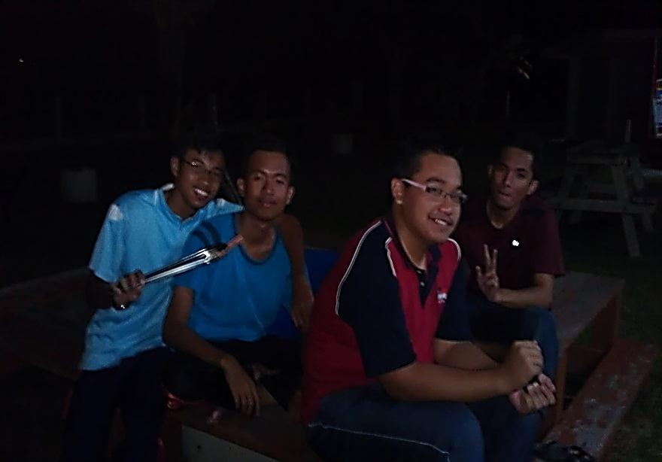
Notes:
Slide 15. In all seriousness, the stress the changes caused cannot be underestimated so a mid-production BBQ was arranged. Everyone left feeling recharged and ready to carry on after consuming about 60 sausages and equal number of burgers and a whole lot of chicken. All Bar-B Q’ed of course. Maintaining the fire was a team effort!

Slide 17
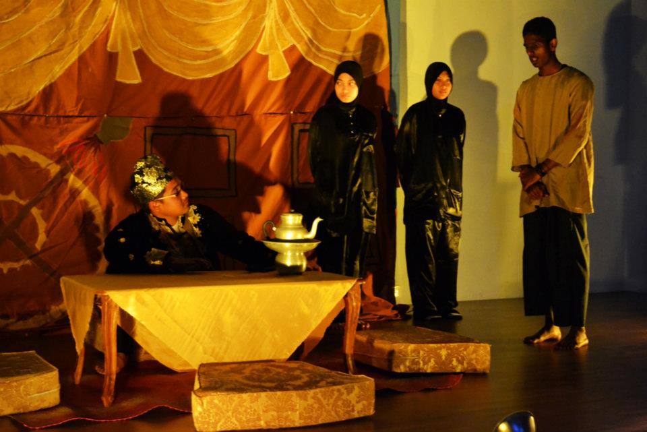
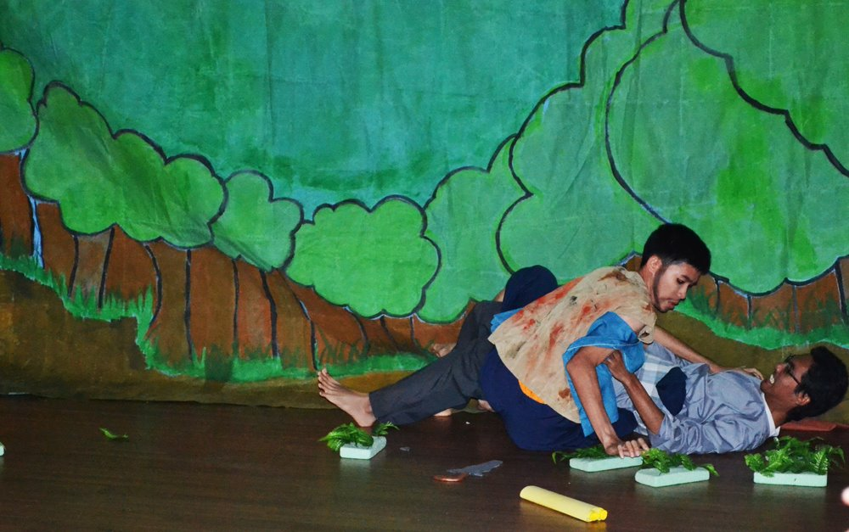
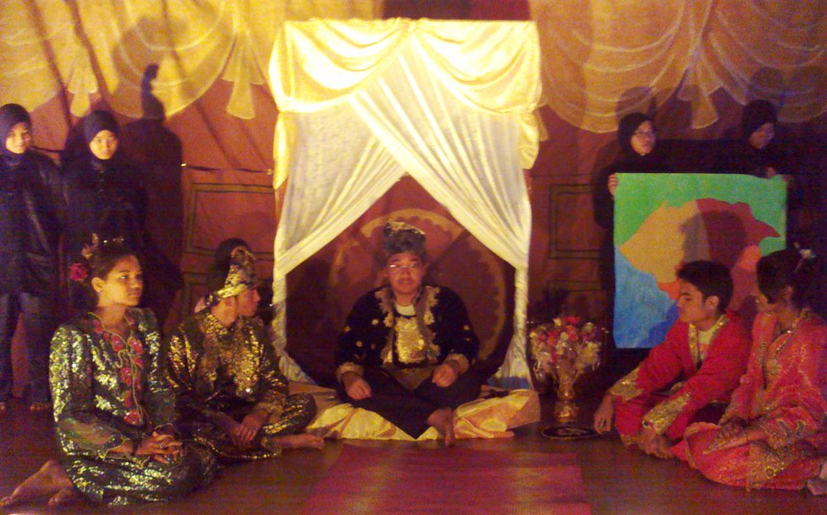
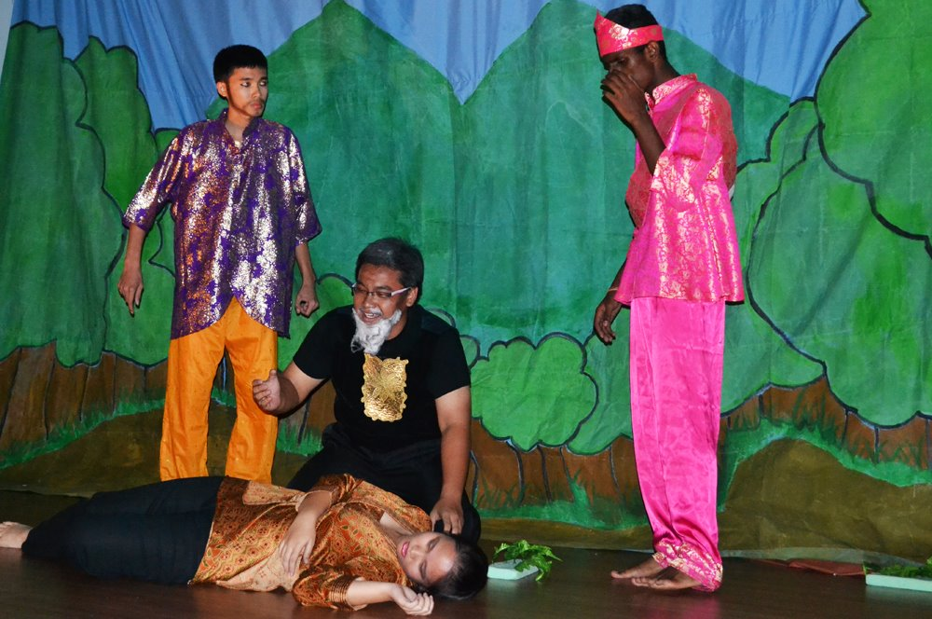
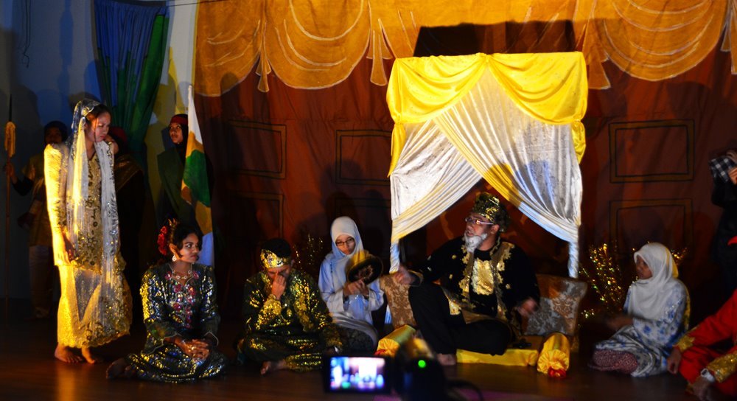
Notes:
Slide 16. The play came together with a heroic effort of cast and crew. The production went on without a hitch, a testament to the Director, Assistant Director and Stage managers’ and everybody’s dedication and tenacity throughout the process which took a month. The makeshift lighting wasn’t good for picture taking during the play but the audience was truly impressed and moved by the play. Puan Zalihar commented that she could see the performers had a clear understanding of the meaning and literary devices in the play and understood the lines they were speaking - which was, after all, the main objective.

Slide 18
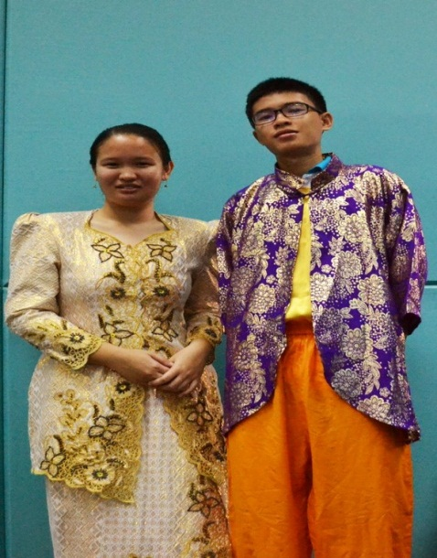
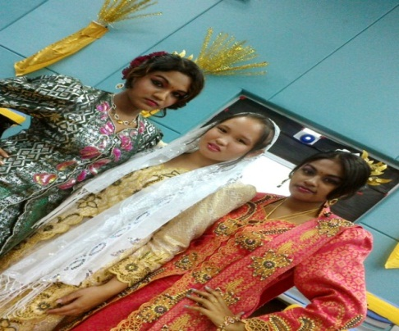
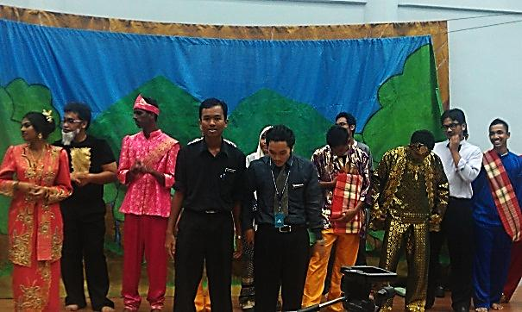
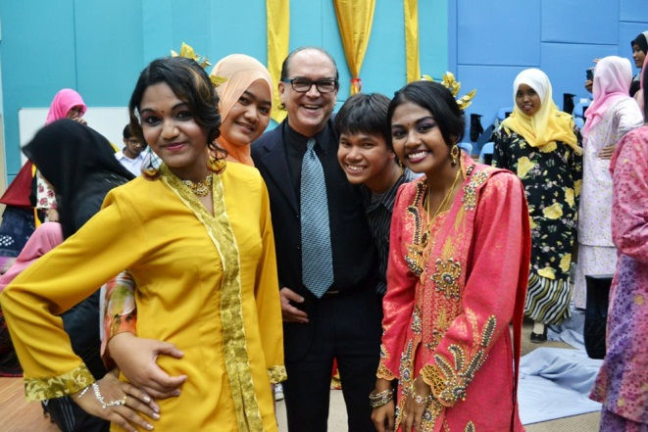
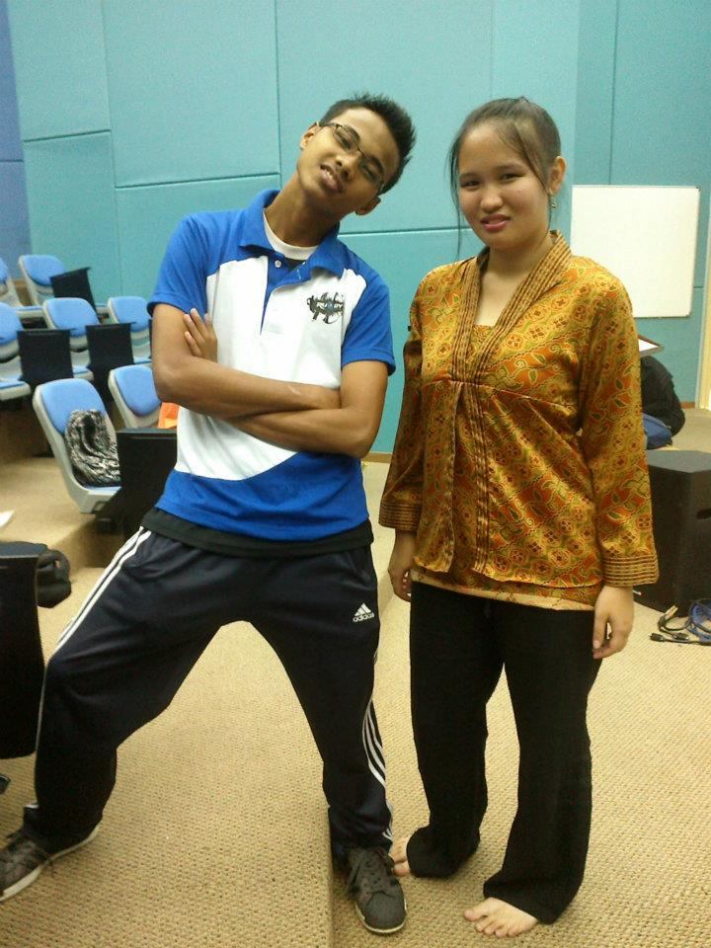
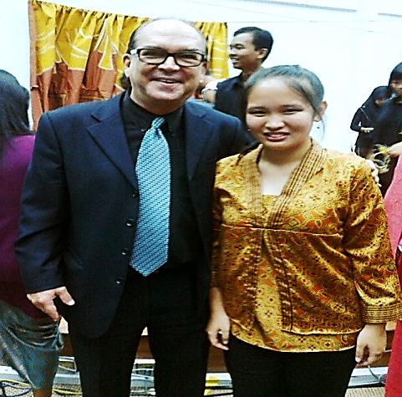
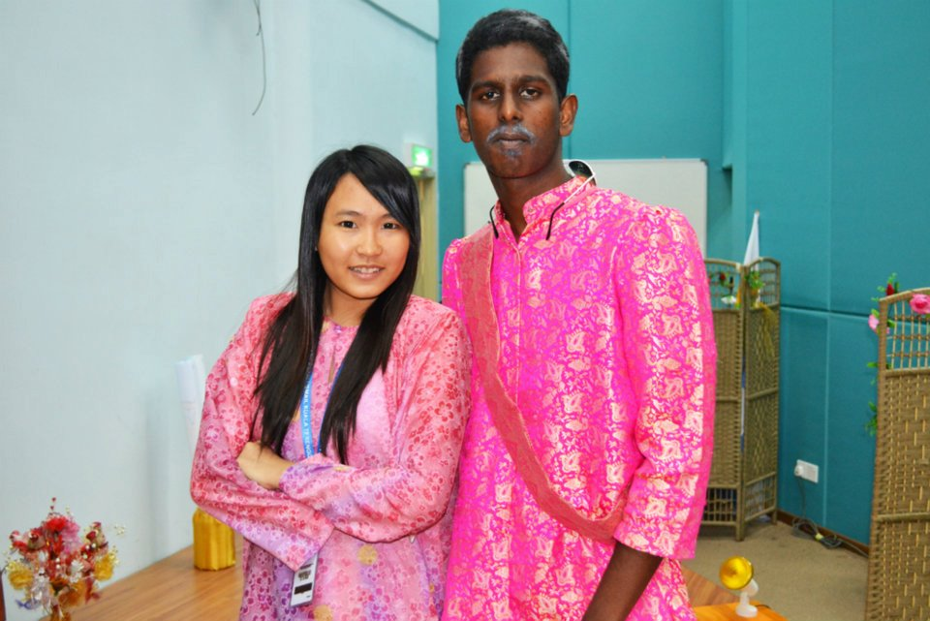
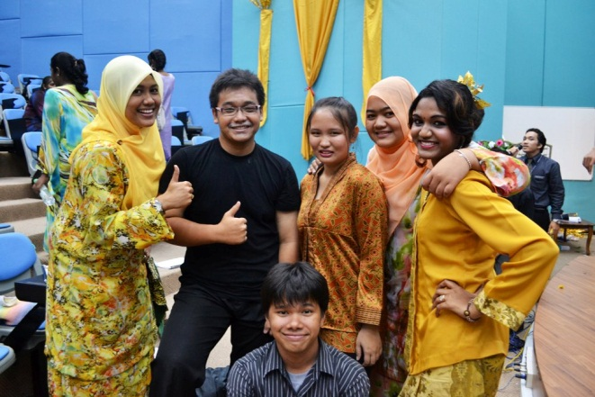
Notes:
Slide 17.There was great satisfaction demonstrable on the faces of the cast and crew after the house lights came up and picture taking was much better. Here you can see the dramatic effect of costumes, make-up and sets and the beaming satisfaction and pride on the faces of everyone whose job was well done. So many people dedicated to one outcome. A good case for Active, Project based Learning.

Slide 19
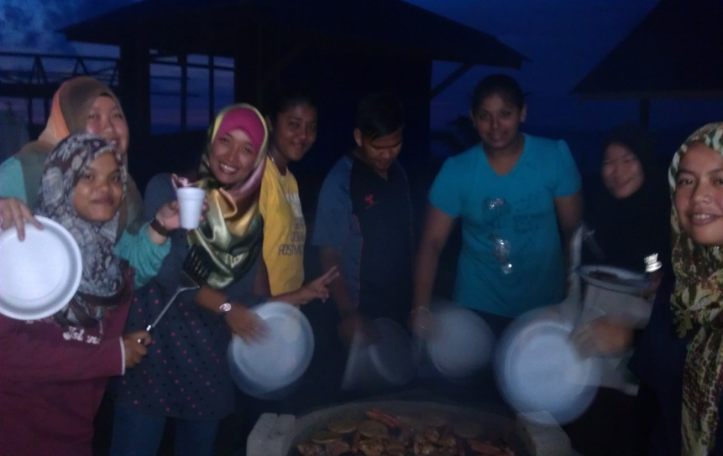
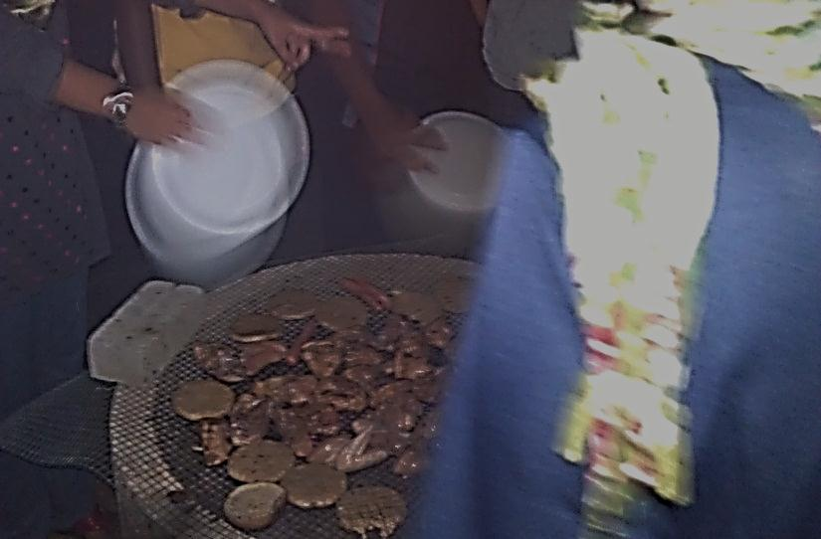
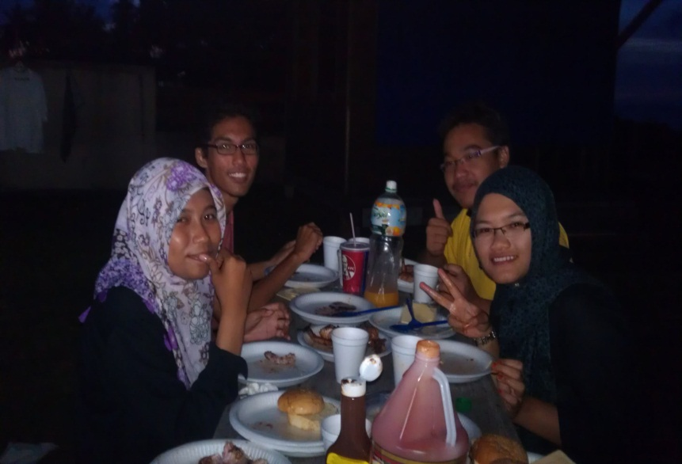
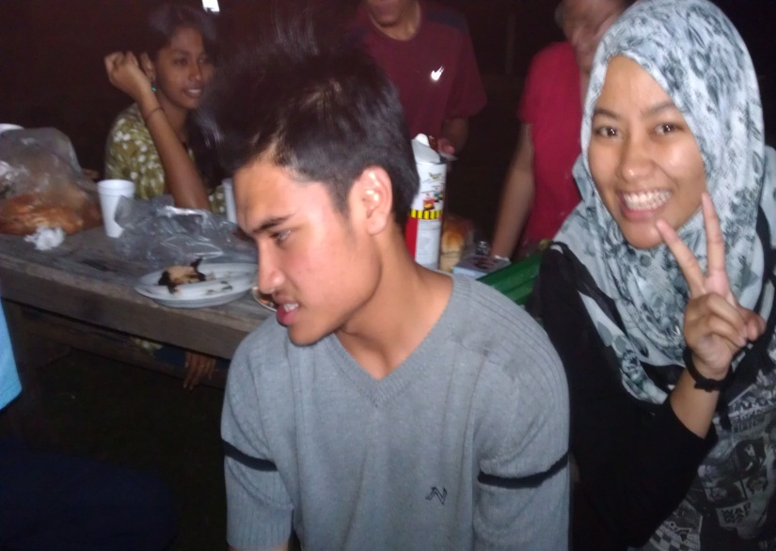
Notes:
Slide 18. The day after the production was a holiday so another BBQ was organized to celebrate the success. Almost twice as many sausages, burgers and chicken was joyfully gobbled-up and the atmosphere was jubilant, the satisfaction with a great team effort for the play and keeping the fire going was obvious.

Slide 20
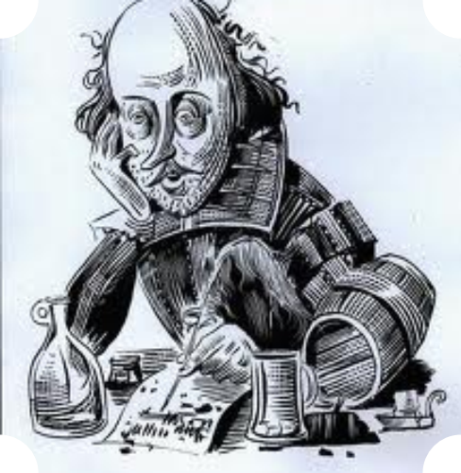
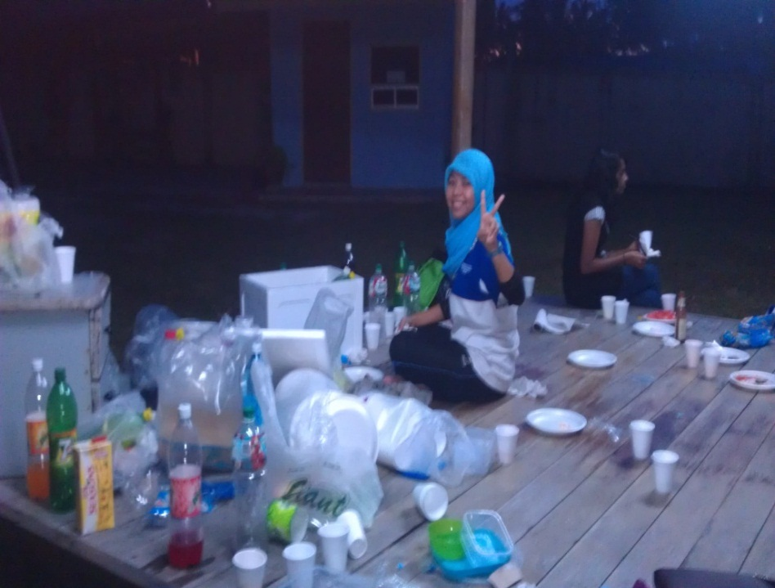
Notes:
Slide 19. After a Production it is always hard to bring down the sets, remove the make-up and costumes and know there will be no show tomorrow; no challenge to remember lines, where and what you’re supposed to be doing on stage; having others rely on you as much as you relied on them. A special kind of teamwork draws to a close. There’s only sweeping up after the cast party to do and go home.

Slide 21
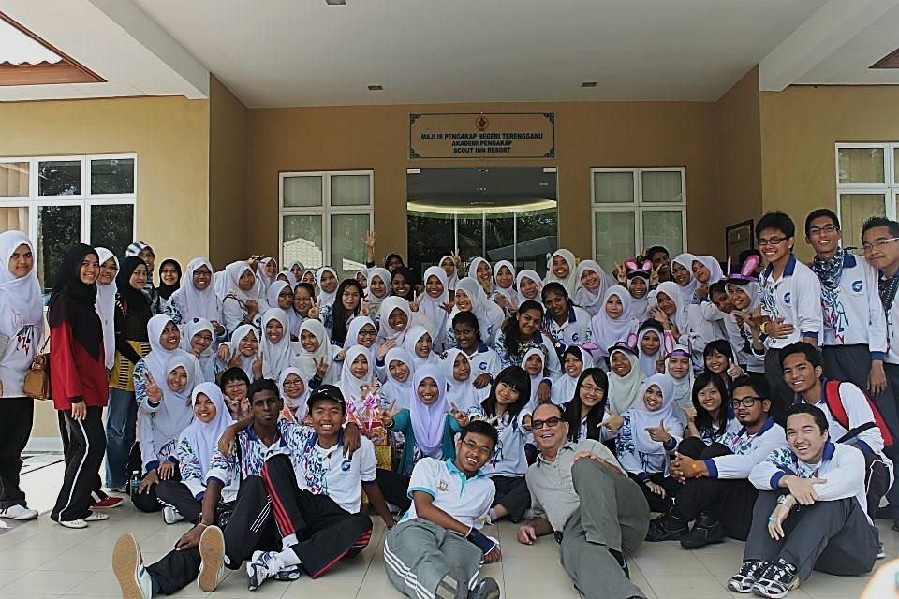
Notes:
Slide 20. This effort will be remembered for a very long time by the members of PPISMP Semester 2 TESL. It was not an easy assignment and there were times when support seemed to be completely absent. But you did it. You overcame the obstacles and your characters are stronger as a result, friendships deeper, and more knowledge stored in the reservoir of experience. I’ll remember the experience and each of you fondly forever. BRAVO!

