Slide 1
PRIME TASK
Think & Link ©
Please complete the PRIME TASK worksheet
BEFORE we begin the workshop.
THANK YOU!

Slide 2
Activating Prior Knowledge
WELCOME TO:
A Must for Learning
For Teachers of English as a Foreign Language in
Upper Elementary & Secondary Schools
With
William M Tweedie & Nurul Izzati Binti Muhammad Fuad
Notes:
1. Welcome and Intro. 2. How many Primary and Secondary Teachers? Form Groups. Hand out Brainstorming Rules. Every concept in learning is grounded in certain beliefs (a philosophy or Approach) about the process of acquiring knowledge. The Approach that underlies my work in EFL is called PRIME. What could the Acronym stand for? Brainstorm.

Slide 3
Brainstorm
P
R
I
M
E
Notes:
Have attendees read the rules for brainstorming.

Slide 4
The PRIME Approach
The Learning Process must be:
PRACTICAL – Doable and Doing (Active Learning)
RELEVANT – Important or Significant to the Students. (Fun is always significant)
INTEGRATED – Language Skills, Learning Styles, Background, Interest, Goals (BIG)
MEANING-centered – Meaningful
ENRICHING – Engaging – Creating a Brighter Future
For more information visit
http://prime-learning.weebly.com
Notes:
My Approach in EFLAF – the Method is SID C ME – only possible if students are given the responsibility for their own learning which comes with setting and achieving specific goals with the assistance and guidance of the teacher. The reward is seeing the benefit and enjoy the fun of learning.

Slide 5
9 PRIME Reading Skills
I
IMAGINING
2S
SKIMMING SCANNING
QUESTIONING/PREDICTING
QP
READING ALOUD
RATE
4R
RHYTHM
RESEARCH
U
UNDERSTANDING
Notes:
I2SQP4R – Skills we hope to practice today in deepening our understanding of how important it is to Activate Students’ Prior Knowledge.

Slide 6
WHAT DO WE MEAN BY
PRIOR KNOWLEDGE
P?K?
Notes:
What is Prior Knowledge? And Why Activate it? I group four aspects of being a human student under the one umbrella term.

Slide 7
New Experience New Behavior New Attitudes New Knowledge
Self
Experience
Knowledge
Attitude
Behavior
New Attitudes New Knowledge New Experience New Behavior
Notes:
Experience and Knowledge are directly related to Attitude and Behaviour. Positive progressive experience and knowledge lead to positive and progressive attitudes and behaviours. To understand and retain new information in what they are reading, students’ need to connect this information to a framework of what they already know and understand. Reading Specialist Dr. Suzanne Clewell explains this idea with an example.

Slide 8
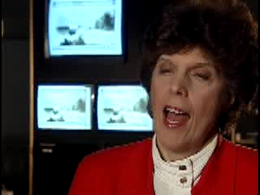
Activating Prior Knowledge (APK):
A Framework to Integrate New Information
http://www.thinkport.org/career/strategies/reading/activate.tp#1

Slide 9
APK in EFL Contexts
A. Content Knowledge
How do you tap a rubber tree?
B. Language Ability
How do Monitor Lizards swim?
Why do my students act so crazy?!
Notes:
If the student knows but can’t say in English the teacher must be aware of this. L1 is therefore necessary to focus on building lexis and ability. Now let’s get to the sampling of strategies and activities we selected for today. First Strategy is Using Poetry

Slide 10
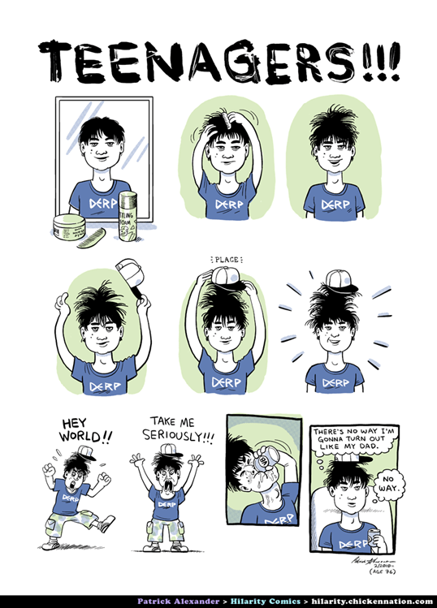
We Try to Help them Learn!
But it ain’t easy!!!

Slide 11
Strategies & Activities to APK
Use Word Poems To
Activate Prior Knowledge
As Warm-ups To A Topic
TEENAGERS !
Notes:
Write simple word poem about teenagers.

Slide 12
Question-Answer Relationships
Develop
one each of the 4 types of
Questions
“Why teenagers find learning a drag”
Notes:
Good strategy for informational or narrative texts.

Slide 13
OUR QARs
In the Book:
  What part of the brain is involved in learning?
In my Head:
  Can this explain (partly) my students’ attitudes and behaviours?
Think and Search:
  How is the hippocampus involved in learning?
Author and Me:
  Should I share this information with my students?
Notes:
Compare your questions to ours and your groups’. What other factors are involved in learning difficulties?
What are receptors and how many are just right?
Will it help?

Slide 14

Diamante Poem
Reading
Informative Pleasurable
Stimulates Engrosses Compels
In a quiet place
Creates Persuades Satisfies
Challenging Stressless
Writing
Your Poem Topic: MICE

Slide 15
Compare and Contrast
Use the worksheet to compare and contrast your ideas of the characteristics of City Mice and Country Mice
You can also use Similarities & Differences using a matrix:
SAME
Different
SAME
Different
SAME
Different
SAME
Different
Notes:
Show sports example. Share your ideas with your group or with the class if called upon. Habitat, food, size & other physical attributes, life span, dangers, etc. Note: reference to graphic organizers

Slide 16

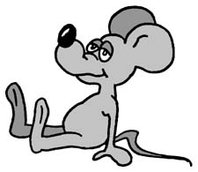
The City Mouse and the Country Mouse
A READ ALOUD:
An Ancient Fable from Aesop’s ABC compiled by Heather Forest http://www.storyarts.org
Notes:
APK is not only for words. It also involves the sounds, rhythm, stress, intonation of words. Reading Aloud is one of the most effective strategies because students must Imagine or construct images based on what they hear and see the reader do. These aspects are valuable clues to meaning as well.

Slide 17
Shape Poem
Each member of your group chooses a different one of the following to create a shape poem:
Group 1 Group 2 Group 3 Group 4 Group 5
Frog bear bananas flower pond
Hornbill rabbit milk pear armadillo
Monkey cow carrot egg leaf
Lizard snake cheese bean root
Mouse cat rice potato raindrop

Slide 18
The Elements of THIEVES
Please Scan the elements of THIEVES handout.
Use this strategy BRIEFLY: In turn, describe to your group the key topics and facts in your article from “Life on Earth.”¹
The other group members will formulate 1 or 2 questions each to ask about the article.
Are these Topics Relevant to you and your students?
¹From 1000 Questions and Answers © 1997 Bookmart Limited
Notes:
Life on Earth Readings. The KWL Strategy may be substituted if time is short.

Slide 19

Building Vocabulary while APK
Cloze Activity
You Are Beautiful As You Are
Aesop’s Fables
An Ancient Fable from Aesop’s ABC compiled by Heather Forest
http://www.storyarts.org
Notes:
The story is on your worksheet with words some students might not know. For secondary students have them fill in words without the word box first. Next they can look at the word box to check for synonyms they might have used, or other words that could also be used in the story.

Slide 20
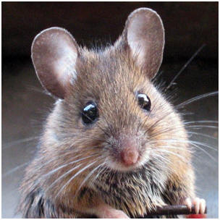
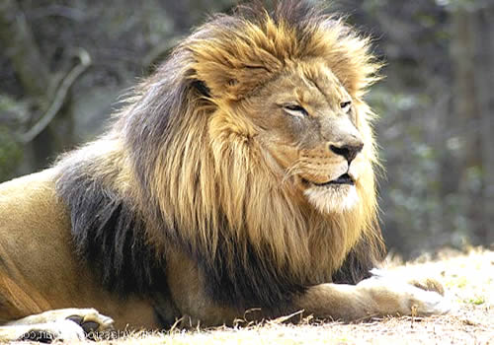
PREDICTING
The Lion and the Mouse
Your Fable in 3 Parts
An Ancient Fable from Aesop’s ABC compiled by Heather Forest
http://www.storyarts.org

Slide 21
Your CD Contains:
100’s of Strategies, Activities, Lesson Plans, and Worksheets
Conference Presentation Material
A Complete Book of 26 Graphic Organizers
More than 600 Stories: Fairy Tales, Fables, Short Stories, etc.
Theoretical and Reference resources for APK
16 Videos demonstrating how to use some of the Strategies, Activities and Lesson Plans

Slide 22
Thank You So Much!
Izzati and William appreciate your hard work and wish you:
The Very Best of Luck and Happiness in Helping
Students to Love Reading!
By Activating their Prior Knowledge
Email: Izzati – redblack_brat@yahoo.com William: william.tweedie@yahoo.ca

